Slide 1
Climate
7th Grade

Slide 2
Climate
What is Climate?
As a Group come up with a definition of this term. Just use each others brains, no other resources.

Slide 3
Climate
Climate is the pattern of weather that occurs in an area over many years.
Climate determines that types of plants and animals that can survive, and it influences how people live.

Slide 4
Factors that can effect a locations climate
Latitude on Earth
Land forms like mountains and cities
Lakes and oceans
Ocean currents
Wind

Slide 5
Latitude and climate
Regions closest to the equator receive more solar radiation and this effects their climate.
Polar Zone
Temperate Zone
Tropics

Slide 6
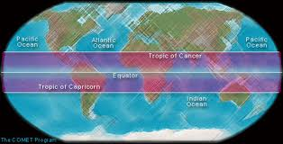
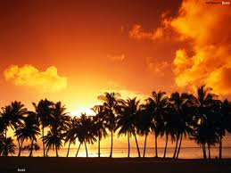
Latitude and Climate
Tropics
Latitude between 23.5 north - 23.5 south
Receive that most solar radiation(Direct sun)
Always hot, unless at a high elevation

Slide 7
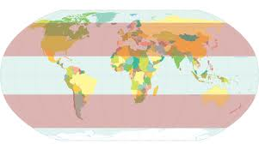
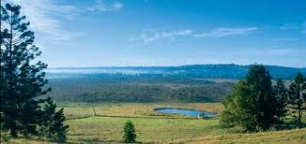
Latitude and Climate
Temperate Zone
Between 23.5 and 66.5 North and South
Temperatures are moderate
Most of the United states are in this zone

Slide 8
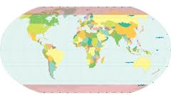
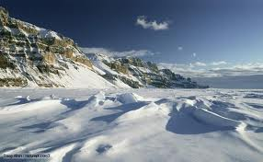
Latitude and Climate
Polar Zone
Extends from 66.5 N and S to the poles of Earth
Solar radiation hit these zones at a low angle, spreading the energy over a large area.
Never warm

Slide 9
Large bodies of water
May effect the climate by absorbing and letting off heat at a different rate of the land around it

Slide 10
Ocean currents
Warm currents flow from the equator and warm the coastal land in higher latitudes.
May cause wetter climate as well
Cool currents flow back toward the equator and cool the air near the equator.

Slide 11
Mountains
Climate is always colder at the same latitude up in the mountains rather than at sea level.
Why? Thinner less heated air higher in the atmosphere.
Rain Shadows: when mountains cause climate to be different from one side to the other.

Slide 12
Cities
Streets, parking lots, and buildings absorb and give off a lot of heat and heat the atmosphere.
Air pollution traps the heat. (Heat-island effect)
Cities often can be 5 Degrees higher than in surrounding rural areas.

Slide 13
List four factors that effect climate of an area.

Slide 14
Factors that can effect a locations climate
Latitude on Earth
Land forms like mountains and cities
Lakes and oceans
Ocean currents
Wind… we will learn about next

Slide 15
Questions?

Slide 16
Show me what you remember! ☺
Review: I’m thinking of a word….
Infiltration
Transpiration
Precipitation
Condensation
Evaporation
Conduction
Convection
Radiation

Slide 17
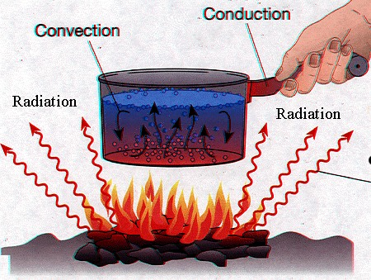
Summary of Heat Transfer

Slide 18
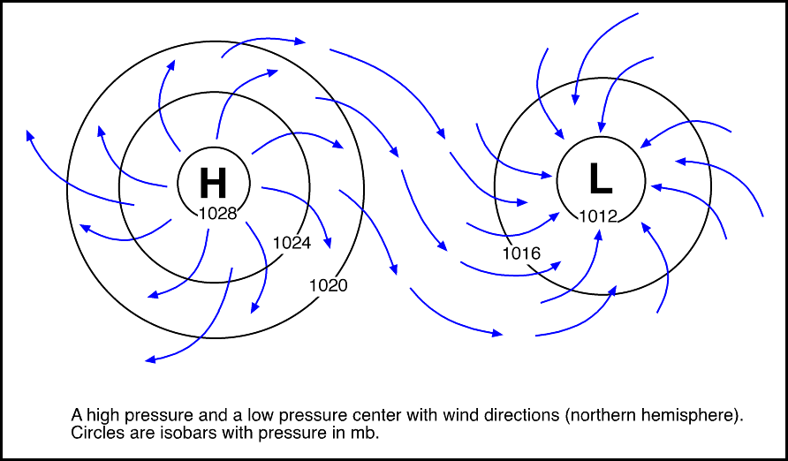
Air Movement
Wind: movement of air from an area of higher pressure to an area of lower pressure.

Slide 19
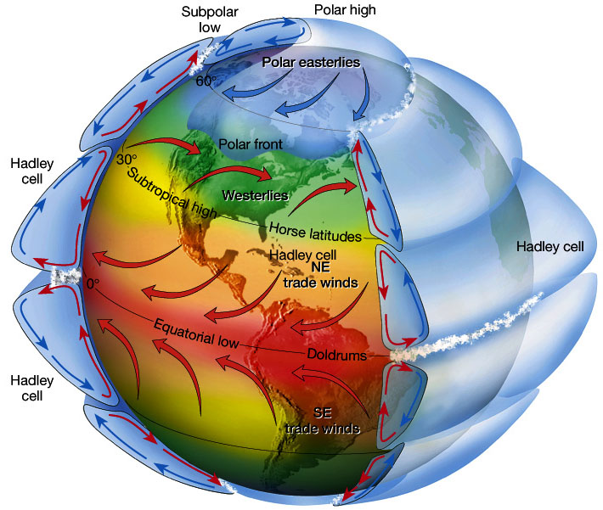
Air Movement
The Coriolis Effect: causes the air in the northern hemisphere of our earth to turn to the right and the air in the southern hemisphere to turn to the left.
http://youtu.be/mcPs_OdQOYU

Slide 21
Balloon Coriolis effect DEMO

Slide 22
Air movement
Doldrums: windless rainy region close to the equator!
Why? Near the equator, the sun heats the air and causes it to rise, creating low pressure and little wind. The rising air eventually cools and it then rains.

Slide 23
Air movement
Jet Stream: Narrow belt of strong winds high in the troposphere blowing in the East direction.
Why is this called the “Jet stream”?

Slide 24
Air movement
Sea and Land breeze:
Sea breeze comes from the sea
Land breeze comes from the land

Slide 25
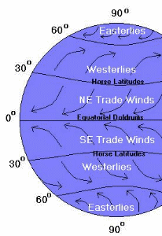
Air movement
Easterlies: come from the east and blow toward the west. Located at the poles.
Westerlies: Come from the west and blow toward the East.
Trade winds: Come from east and blow toward the west (Sailors used these back in the day to Trade STUFFF.. Yes Stuff ☺ )

Slide 27
Questions
Climate vs weather
https://youtu.be/YbAWny7FV3w

Slide 28
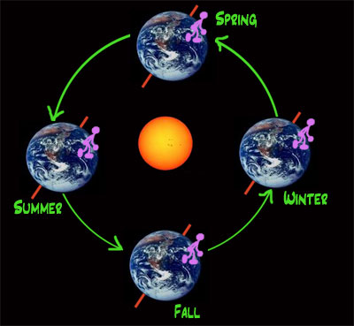
Section 3: Climatic Changes
Earths Seasons: Are short periods of climate change caused by changes in the amount of solar radiation an area receives.

Slide 29
El Nino
El Nino: Weak wind, from the warm tropical water in the upper layers of the pacific ocean flow eastward to South Africa
Ocean temperatures increase from 1-7degrees Celsius of the cost of Peru.
Can effect the weather patterns in these areas.

Slide 30
La Nina
Opposite of El Nino!
Strong winds, causing warm water to accumulate in the western Pacific. The water in the eastern pacific near Peru is cooler than normal.
May cause droughts in southern united states and excess rainfall in north western US.

Slide 31
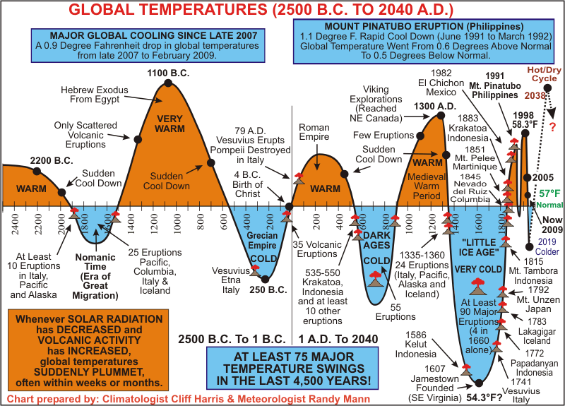
Climate Change Records
Earths climate has been generally cooler in the past and has also been generally warmer at other times in the past.

Slide 32
What can cause climatic change?
Atmospheric solids and liquids
Block solar radiation
Energy from the sun
Sun spots can cause less solar radiation
Earth movements
Earths axis varies from 21 to 24 Degrees
Amount of solar energy
Change in axis can increase/ decrees solar radiation on earth.
Crustal plate movement
Movement of land and ocean effects heat transfer

Slide 33
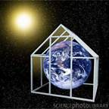
Climatic Changes Today
Many people are concerned about our current climates increase in temperature.
Some believe the greenhouse effect may be the cause of this temperature increase.
Greenhouse effect: Natural process of heat being trapped by gases in our atmosphere.

Slide 34
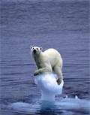
Climatic Changes Today
Earths temperature has increased about 0.6 degrees Celsius globally. This is known as global warming.
Possible causes: carbon dioxide emissions have increased by 20%! Suns solar radiation has decreased.
Effects: glaciers will melt, sea levels will rise, coastal land will flood, tropical climates will die in the seas.

Slide 35
Human Activities
What are some human activities that may effect our atmosphere??

Slide 36
Review
Climate
Air movement
Condensation
Coriolis Effect
Doldrums
Hydrosphere
Jet Stream
Land Breeze
Latitude
Polar Easterlies
Polar Zone
Prevailing Westerlies
Rain Shadow Effect
Sea Breeze
Temperate Zone
Trade Winds
Tropics
El Nino & La Nina
Greenhouse effect
Global warming
Human Impact
Carbon Cycle

Slide 37
Questions

Slide 38
Adaptations
An Adaptation is any structure or behavior that helps an organism survive in its environment.
Structural Adaptations
Behavioral Adaptations

Slide 39
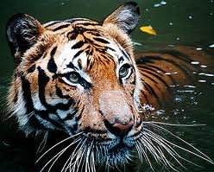
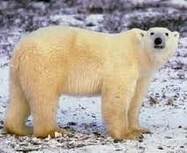
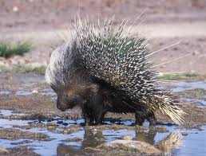
Structural Adaptations
Body structures that help the organism.
Fur on mammals
Thorn on a cacti

Slide 40
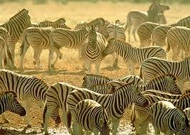
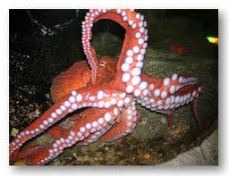
Behavioral Adaptations
Organisms may display behavioral adaptations.
Rodents and other mammals may have a period of greatly reduced activity during hibernation or estivation to save energy.
Desert turtles obtain their water from other things they eat.

Slide 41
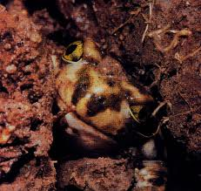
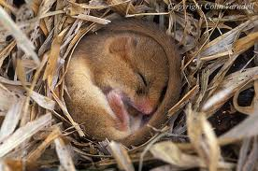
Hibernation and Estivation
Period of inactivity
Hibernation= in the winter when it is too cold
Estivation= in the summer when it is too hot

Slide 42
Bell work Section 2
What are the two types of Adaptations? Give one example of each

